Slide 1
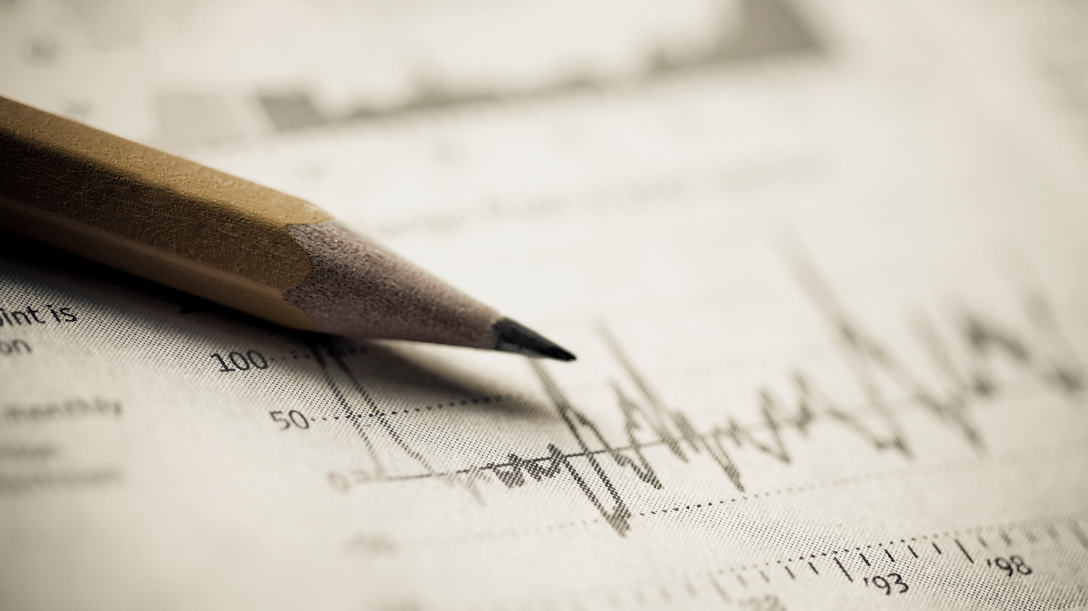
2019 Baseball Hitters Analysis
Richard Burson

Slide 2
Data
Variables
360 variables with 8 variables
Hitter from 2019 with at least 200 AB in the season
Questions:
Who were the best hitters of 2019?
Are there players you can identify that might be underrated that teams could try and pursue?
xBA – Expected Batting Average
xSLG – Expected Slugging Percentage
xwOBA – Expected Weighted On-Base Average
xOBP – Expected On Base Percentage
xISO – Expected ISO
Average Exit Velocity – the Average Exit Velocity on balls hit by a player over a season
Average Launch Angle - the Average Launch Angle on balls hit by a player over a season
Barrel% - Percent of the time a player barrels up the baseball

Slide 3
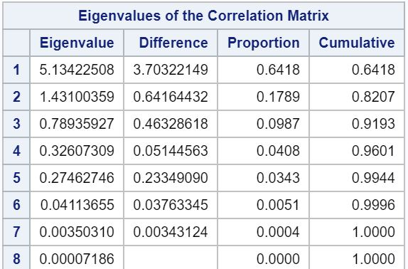
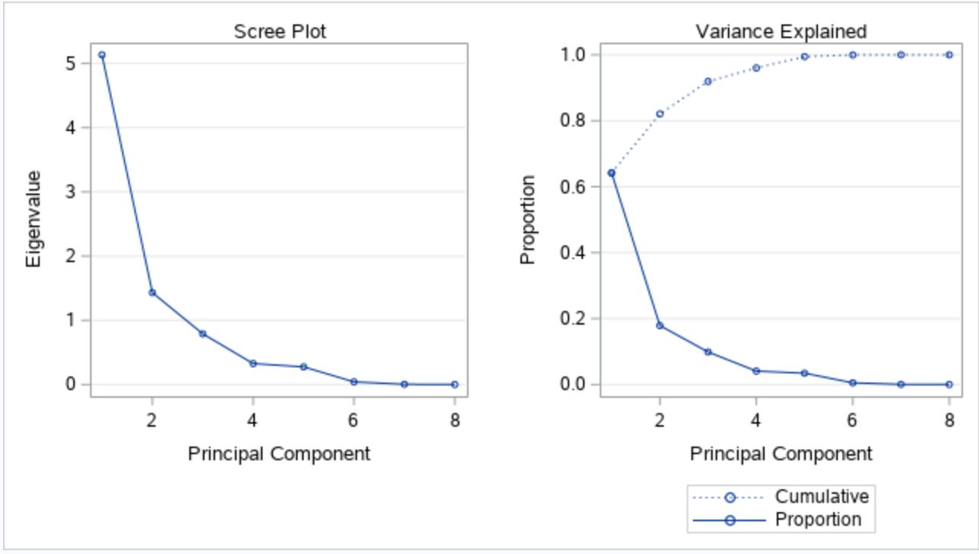
PCA Output

Slide 4
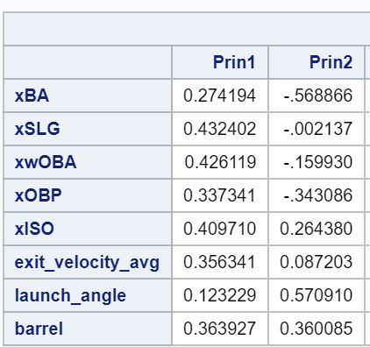
PCA Output
Principal component 1 looks to be a comprehensive stat for how good a hitter is
The higher the value of principal component1 the better the hitter
Principal component 2 contrasting the launch angle, xISO, and barrel variables with xBA and xOBP variables
In baseball terms it looks to be contrasting contact/average hitters(low LA/high batting average and OBP) with sluggers(high launch angle and power with low BA and OBP)

Slide 5
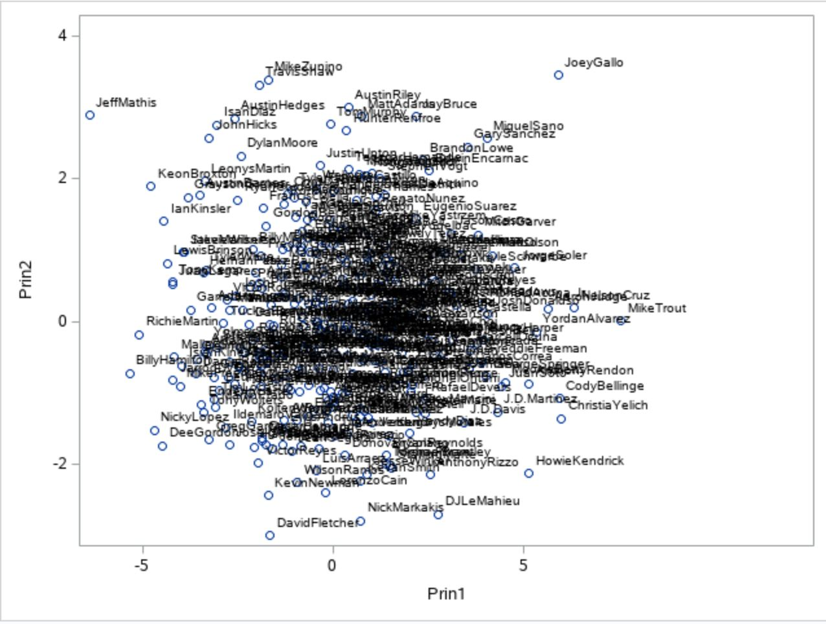
PCA Plot
- Joey Gallo
- DJ Lemahieu
- Mike Trout
- Richie Martin

Slide 6
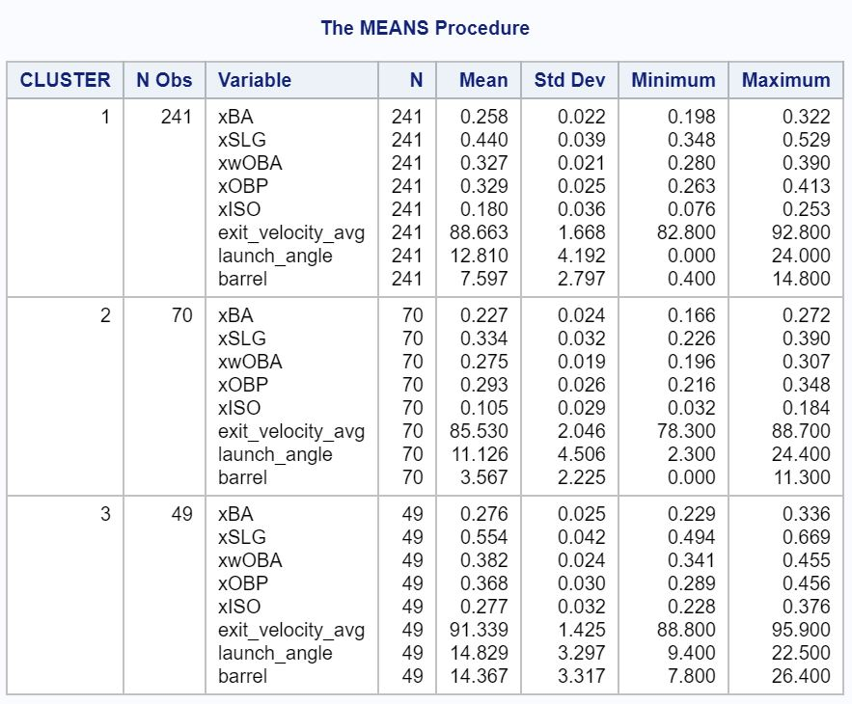
Cluster Analysis
Used complete cluster method
Cluster 1 seems to be the middle of the pack hitters.
Cluster 2 are the below average hitters
Cluster 3 are the good hitters

Slide 7
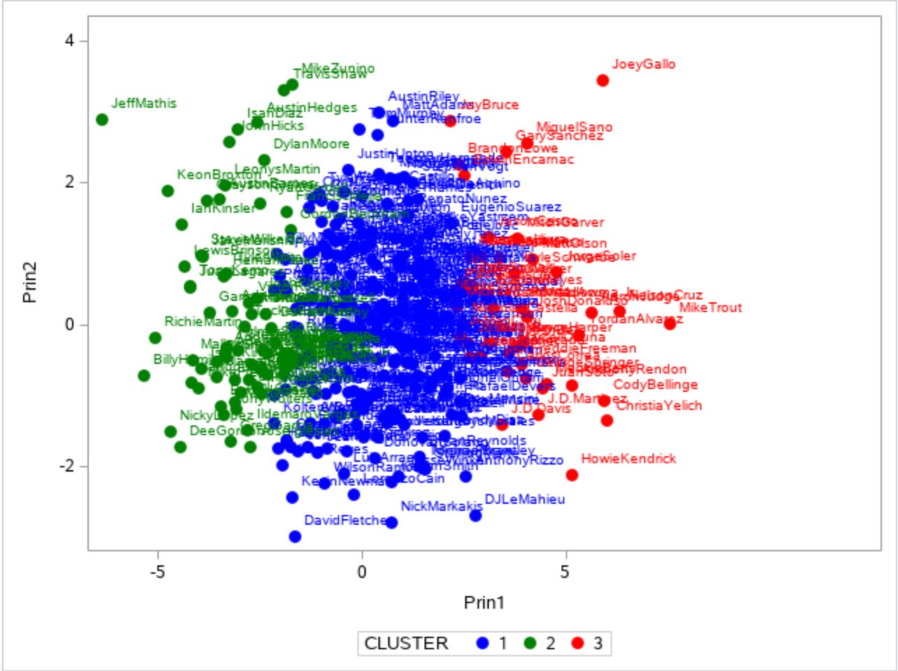
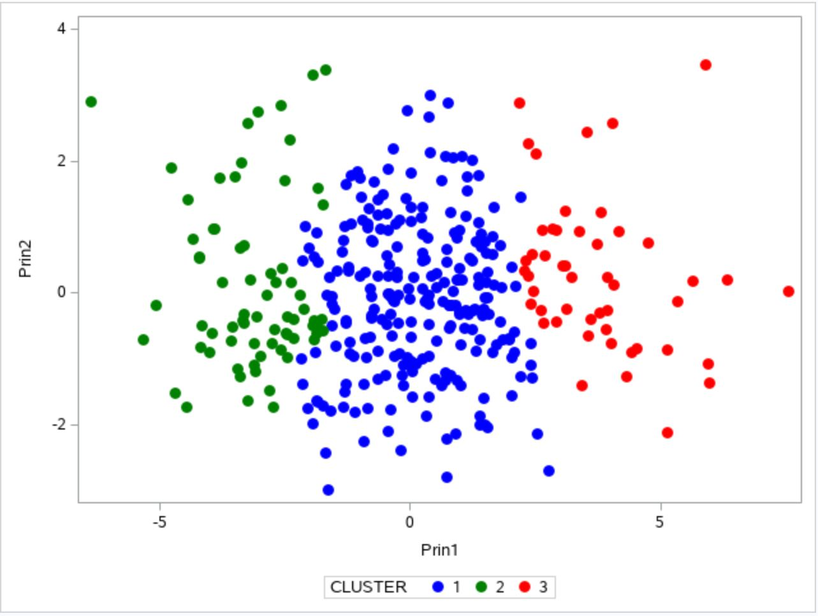
Cluster Analysis Plots

Slide 8
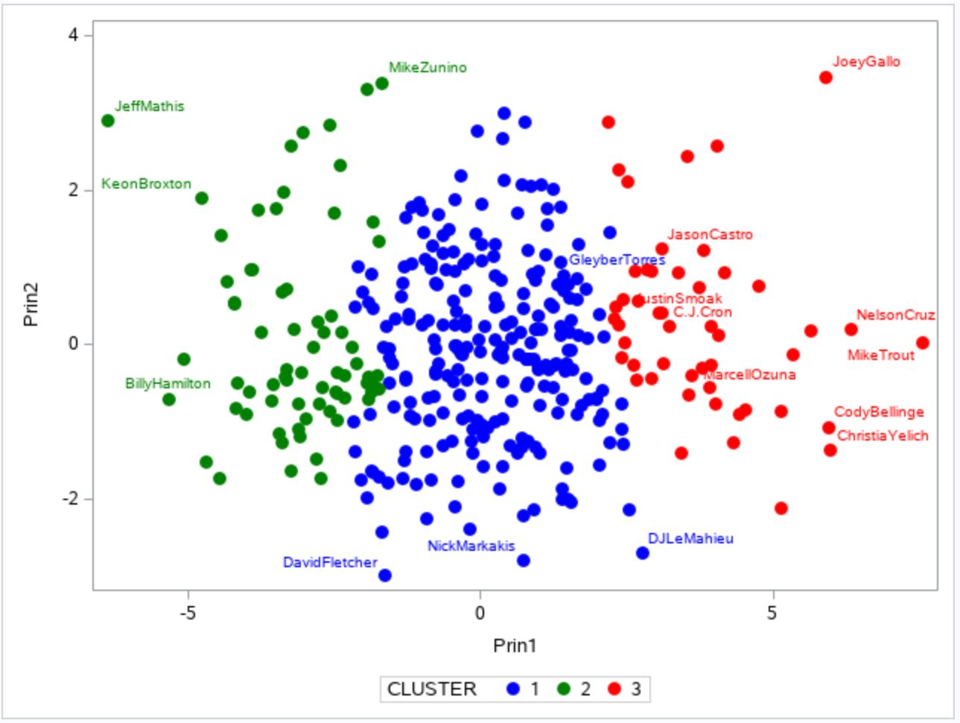
Conclusions
Not surprised at who were the best hitters of 2019
- Trout, Cruz, Yelich, Bellinger, Gallo
Identified C.J. Cron, Jason Castro, Justin Smoak, and Marcell Ozuna as possibly undervalued players
This analysis can also potentially help find overvalued players as well such as Gleyber Torres

